Slide 1
Shaping the future mobility with business model innovation: Regulatory support and challenges
Final Conference
Ping-Jen Kao, UCL
25 August 2021​

Slide 2
Contents
New mobility services and technologies and their business model
Regulator support/challenges for sustainable business model innovation
The impact of COVID-19 on sustainable business model innovation

Slide 3
New mobility services and technologies that GECKO reviewed
LIST OF NEW MOBILITY SERVICES AND TECHNOLOGIES REVIEWED:
Connected, Cooperative And Automated Mobility (e.g. connected & automated vehicle, drone delivery)
Infrastructure, Network And Traffic Management (e.g. big data in traffic management; hyperloop)
MaaS and MaaS platforms
Shared on-demand Mobility (e.g. ride hailing; bike sharing)
Review based on these criteria:
Technological
Operational
Social/ behavioral
Business
Security/cybersecurity, safety, data protection etc.
More details can be found in D1.1 & D1.4 on the GECKO website.
Notes:
Briefly discuss what new mobility services and technologies we have investigated.

Slide 4
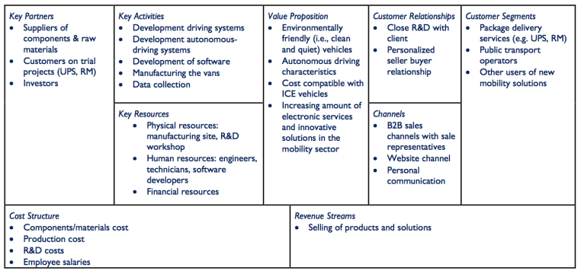
The constraints and opportunities of current business models
Illustration of Analysis on CCAM
More details can be found in D1.2 on the GECKO website.
Notes:
We investigated the existing business models (Business model canvas to look into how firms propose, create, deliver and capture value from their innovations).
Then we explored the constraints and opportunities of current business models
Here illustrate an AV company‘s business model
This findings serve as the basis of our further investigation in workshops.

Slide 5
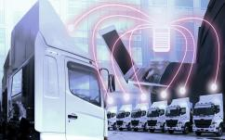
Regulatory support/ challenges for sustainable business model
Support
Transparent and well-established data policies
Public education
Stronger public-private partnership (PPP) Model
Data standard, APIs, and other policies are difficult to be consistent especially given the nature of data variety.
Persuade people to adopt new mobility services and technologies for environmental reasons is not always an effective way. (where is economic benefits).
The city needs to make sure the collaboration is profitable and sustainable.
The public/private dialogue is region-specific, it’s a city to city approach.
Challenges
Notes:
Based on the findings of previous stakeholder workshops… for sustainable business model innovation
Transparent and well-established data policies: MaaS - key is that the data protocols that should be shared between different cities/countries
Public education: Public authorities to educate and communicate with end-users to show how their choices are impacting the environment will also be important.
Stronger PPP model: to support customized mobility packages and services; Strong partnership public-private – the city needs to make sure that collaboration is sustainable and profitable

Slide 6
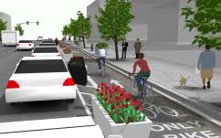
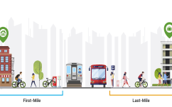
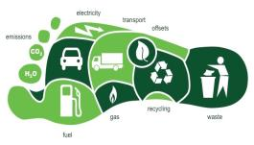
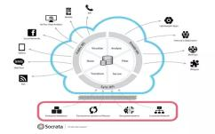
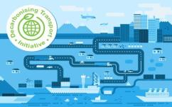
Regulatory support/ challenges for sustainable business model
Support
New urban space allocation
Subsidies for peripheral transportation
Assessment of the environmental footprint
Why would cities provide spaces for business that make money? The private sector needs to prove the benefit for the municipality.
New players and innovators need to prove the contribution to the city objectives, benefits for the local community in order to receive support, possible subsidies, etc.
Need to “charge” the environmental impact.
What are standards for environmental footprint across cities/regions?
Challenges
Notes:
Urban space is a key resource: parking spaces, biking lanes, pedestrian sidewalks. Municipalities can promote one mode over another through granting the access to public space.
Subsidies for peripheral transportation: subsidising the first mile or to motivate public to use public transport like trains.
Assessment of the environmental footprint: and monitoring performance indicators could be additional value propositions

Slide 7
The impact of COVID-19 on sustainable business model innovation
The pandemic is a double-edged sword for sustainability
A trend of more home-based living and working environment
Moving goods and services without human interaction is a preferable option
Potentially increased car ownership in the future
Notes:
D1.4 investigated the impacts of COVID-19 on these innovations as well because the pandemic has significant influences on the sustainable urban mobility and might potentially facilitate / deter some disruptive innovations. For instance, COVID-19 might have a lasting impact on CCAM innovation category as it is driving significant changes in the macroeconomic environment, regulatory trends and public acceptance to disruptively new mobility technologies. This pandemic is a double-edged sword for the goal of sustainability. On the one side, as the world has shifted to a more home-based living and working environment, moving goods and services without human interaction is more important than ever before. It is therefore a turning point to accelerate the transition toward CCAM, with the introduction of CAVs, UAM and drones. On the other side, it might contradict to the goal of sustainability because of the potentially increased car ownership in the future. It is therefore important to avoid contradiction with the goal of sustainable mobility in Europe.

Slide 8
Thank you for listening
Ping-Jen Kao, UCL, p.kao@ucl.ac.uk
The sole responsibility for the content of this document lies with the authors. It does not necessarily reflect the opinion of the European Union. Neither the INEA nor the European Commission are responsible for any use that may be made of the information contained therein.

