Slide 1
GECKO Stakeholder Workshop 3 Wrapping up
15-03-2021

Slide 2
STAKEHOLDER WORKSHOP 3
 | Tuesday | Wednesday | Thursday
AM | Conflicting (and converging) interests 1 Identify differences in goals and needs between the private and public sectors in new mobility. | Looking ahead to 2040 – challenges In the context of a scenario for the mobility situation for 2040, stakeholders prioritised the challenges faced. | Recommendations Addressing policy statements around the regulation of new mobility (passenger and freight). What’s keeping us from getting there? Where do responsibilities lie?
PM | Conflicting (and converging) interests 2 Identify differences in goals and needs between the private and public sectors in new mobility. | Looking ahead to 2040 – actions In the context of a scenario for the mobility situation for 2040, stakeholders identified some actions to meet the identified challenges. | Wrapping up What have we learnt?

Slide 3
Recommendations Joint position paper
Thursday, 15 April

Slide 4
JOINT POSITION PAPER
Political statement on EU regulatory approaches to devise new regulatory schemes, frameworks and governance models
Messages to the European Institutions on issues relating to future mobility to 2040 for passenger and freight
Set key priorities towards adaptive new regulation frameworks

Slide 5
PUBLIC-PRIVATE COOPERATION
What’s preventing us from getting there?
Lack of strong view of the local mobility strategy
Shared responsibility between authority and private
Having a framework within to cooperate and willingness from both sides helps
Local city and transportation authorities should take the strong role
What is the role of the EU?
Set policy direction
Who is responsible for making this a reality
Slow administration process
Unclear role of local authorities
Distrust
Commercial Interests
PAs think local ◀▶ New mobility operators act global
Standardised data framework
Local authority funding
National government
Share good practices
Consultation around common needs
Set a regulatory framework
Collaborative funding
Pushing for an open data standard

Slide 6
DATA
What’s preventing us from getting there?
Complexity
Lack of a fit-all solution
Privacy concerns
Diversity of transport policies across areas
Minimum set of real time data provided for free to authorities
Who is responsible for making this a reality
National or European administration
Local level for analysis
Acquisition at the national/ regulation level
What is the role of the EU?
Set minimum requirements

Slide 7
NEW REGULATORY APPROACHES
What’s preventing us from getting there?
Institutional and regulatory silos ◀▶ regulating across different industries
Who is responsible for making this a reality
Regulators and law makers
What is the role of the EU?
Superior framework that supports decision making processes and provides sort of "justifications"
Regulatory processes are time-consuming, so adaptive governance is limited to certain areas
Delicate handling of tax money
Member states should be the main vehicle for deployment (in the EU)

Slide 8
SUSTAINABILITY, SOCIETY AND SAFETY
What’s preventing us from getting there?
Balancing pedestrian and shared mobility space on sidewalks
'Technology-push’ rather than 'service-push'
Who is responsible for making this a reality
Local authorities can promote active modes
Companies to develop sustainable mobility plans for employees
What is the role of the EU?
Produce and disseminate self-assessment tools to raise awareness
Establish the social impact criteria
Social impacts of new mobility should be a local consideration
Member states to provide support and guidance

Slide 9
Looking ahead to 2040 Adaptive Regulation Roadmap 2040
Wednesday, 14 April

Slide 10
Adaptive Regulation Roadmap 2040
An implementation plan with actions up to 2040 needed to devise adaptive and anticipatory regulatory approaches and identify new regulatory frameworks.
The central aim of the roadmap is “fostering adaptive and anticipatory regulation for new mobility”.

Slide 11
Adaptive Regulation Roadmap 2040
WHERE ARE WE NOW
Challenges in reaching the aim
WHERE DO WE WANT TO GO
GECKO Vision 2040
HOW CAN WE GET THERE
Actions in reaching the aim

Slide 12
MUST be addressed immediately
CHALLENGES
ACTIONS
Neutral (European) platform
New mobility provider to address SUMP
Lack of data sharing
Regulations that vary from city to city
Associations of new mobility providers
Cultural shift away from private car ownership

Slide 13
to be addressed IN THE MEDIUM TERM
CHALLENGES
Legislation moves too slowly for new mobility solutions.
ACTIONS
Standardised way to engage with innovative mobility in the city
New mobility solutions can change user behaviour positively or negatively.
Fair fare competition between new and existing services.
Lack of technical competence in the public sector
The lack of technical standards
Regulations in the local language
Difficult to bring autonomous vehicles into use without real-world tests.
False promises by the private sector
International groups producing technical standards
Data sharing without technical standard
Structured development of regulations can help translation
Private sector should demonstrate how to overcome problems so required competence from public sector is not much
Policy leads, technology enables

Slide 14
to be addressed continuously
CHALLENGES
Differing goals between the public and private
ACTIONS
Regulators sharing bast practice on how to deal with new mobility solutions
New mobility providers are not included in the creation of regulations
Solutions may meet the needs of some end user groups and not others
Funding users directly towards their best mobility mode
Models to drive cooperation e.g., innovation competitions

Slide 15
Conflicting interests

Slide 16
GECKO GUIDELINES FOR NEW GOVERNANCE MODELS
Practical set of guidelines to provide policy makers with reference for new governance models towards integrated, efficient, competitive and sustainable mobility system across all modes of transport
Special attention to
accessibility in cities & public-private cooperation
the role of policies in improving sustainable transport systems and give equal access to all.

Slide 17
TRANSPORT JUSTICE & SOCIAL INCLUSION
Away from the city centre, many suburbanites are either locked into car-dependency (and highly sensitive to restrictions), or captive users of public transport (who dream of buying a car). Accelerating the shift to sustainable mobility requires providing these populations with affordable options.
Transport Justice is about making all modes count (we'll always struggle until non-car-modes have a level playing field with cars)
Diversity of modes of transport provides more resilience to Urban Mobility
Lower-income areas often don't have the access they need (we have to make it appealing or at least viable for private operators to serve them)
All actors are interested in making car use restricted (the monopoly private cars hold over urban space and mobility are harming the emergence of alternative, sustainable, shared modes)
Behaviour change needs time, and private car users need alternatives, and baby steps (provide something closer, e.g., car pooling)

Slide 18
ENCOURAGING ACTIVE MOBILITY
Walking is the most environment-friendly mode of transport, with cycling a close second. We need to reduce transport carbon emissions, but in our sedentary society we also need more active mobility, to improve physical and mental health.
Public Transport and Active Mobility go hand in hand
Bike sharing should be treated as Public Transport
A Shared Mobility user may become a more active person more easily (research shows car sharers walk and cycle more often than car drivers)
Walking and Cycling are about Public Space (not just an issue of “first and last mile”)
The space for walking and cycling has to be there (it has been taken away over the past decades, and is filled with cars, motorcycles, obstacles)

Slide 19
FAIR LABOUR PRACTICES
Some new mobility services, created by highly qualified tech professionals, with generous pay and benefits, are generating thousands of low-pay, no-benefit, “individual entrepreneurs”. The externalisation of labour costs provides a competitive advantage – but who deals with the side-effects?
Not having to offer a living wage provides unfair competitive advantage (vis à vis regulated sectors, and socially responsible competitors in the same sector)
Externalisation of labour costs and venture capital support impossible prices, and race to the bottom (distortion of market eliminates healthy business with long-term perspective, and leaves a hole when going away)
Unfair labour practices harm the reputation of New Mobility Services
The Public Sector can make a difference (e.g., some cities are asking about wages and make funding depend on minimum wages)
Public money should not fund unfair labour practices ((public funding can support job creation, and creation of a critical mass of users, but should not be used to fund unfair competition against regulated actors)

Slide 20
PROTECTING & SERVING THE BACKBONE
Mass Public Transport carries large numbers of passengers, has deep influence in land-use, and (as became evident throughout the pandemic) is what keeps running, when crisis comes. It is the backbone of the urban mobility system – but it has its limitations, regarding capillarity and off-peak periods.
We need a more versatile transport offer (a private car offers reliability and versatility we need to diversify the alternative portfolio)
It is crucial to promote the idea of cooperating rather than competing, of sharing users (integration doesn’t lead to loss of market share, total bigger than the sum of the parts)
Think beyond the first and last mile, and towards demand-responsive transport system (all run under a public umbrella with private operators receiving public support for serving public interest, from night service to quality service for people with disabilities)
Clear commitment to quality public transport and sustainable mobility means vs private car (it’s legitimate and indispensable to “tip the playing field” if behaviour is to change)
Meeting diverse needs is a keystone (if alternative isn’t safe, comfortable, reliable, affordable, why change?)

Slide 21
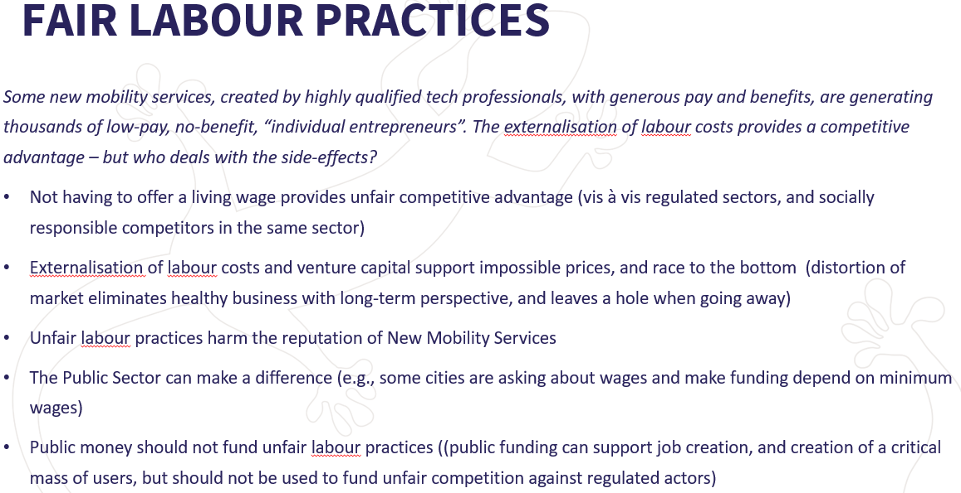

Slide 22
Conflicting interests: https://miro.com/app/board/o9J_lKLXTYM=/
Challenges and actions: https://miro.com/app/board/o9J_lKf_rek=/
Political statements, policy recommendations or key conclusions: https://miro.com/app/board/o9J_lMKu29A=/
MIRO BOARDS ARE STILL ACCESSIBLE

Slide 23
AVAILABLE FROM GECKO

Slide 24
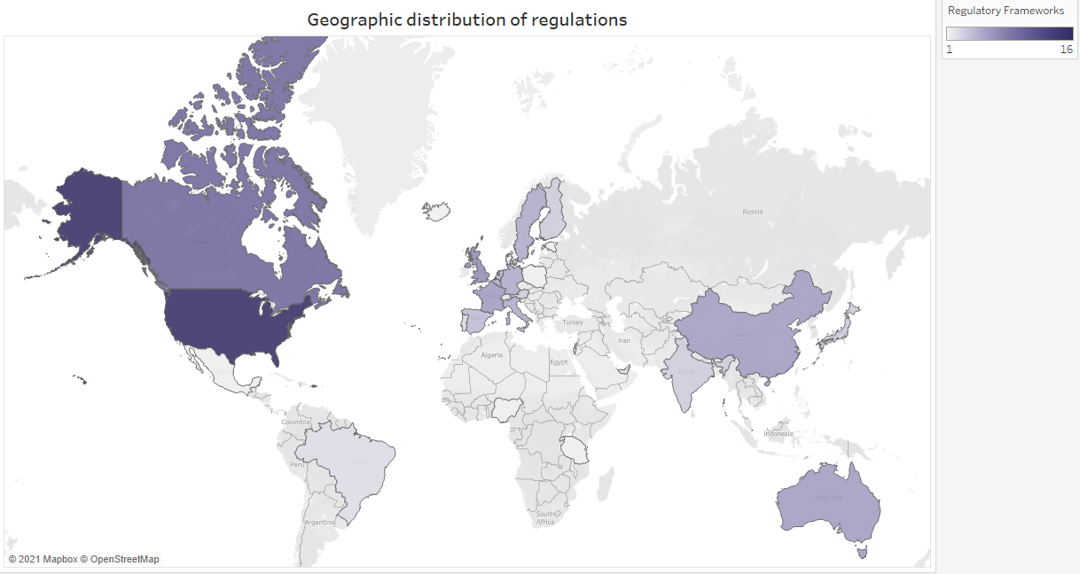
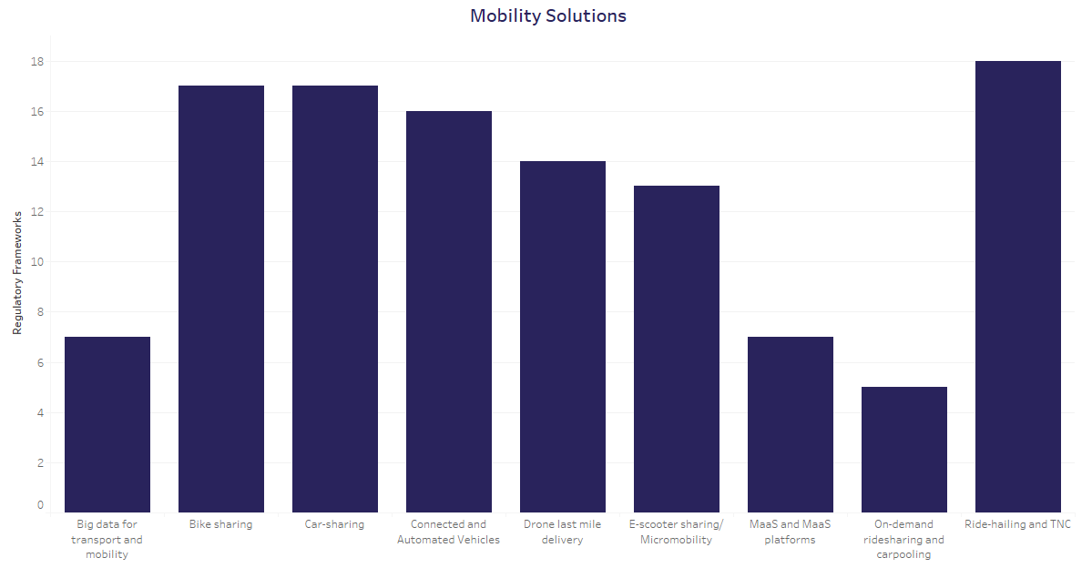
Compliance Map
228 regulations analysed!
Available on the GECKO website here
Notes:
Effectiveness of city/country in regulating
Readiness level of a country’s regulatory framework to allow the introduction of a mobility solutions
Influencing aspects relevant for the deployment of mobility services, business models and technologies.

Slide 25
Final research on governance of mobility innovations
Report covering regulatory responses and governance models for mobility innovations
At different levels (International, EU, national, local)
Approaches and governance models
Case studies of how particular innovations are governed
Available on the GECKO website here

Slide 26
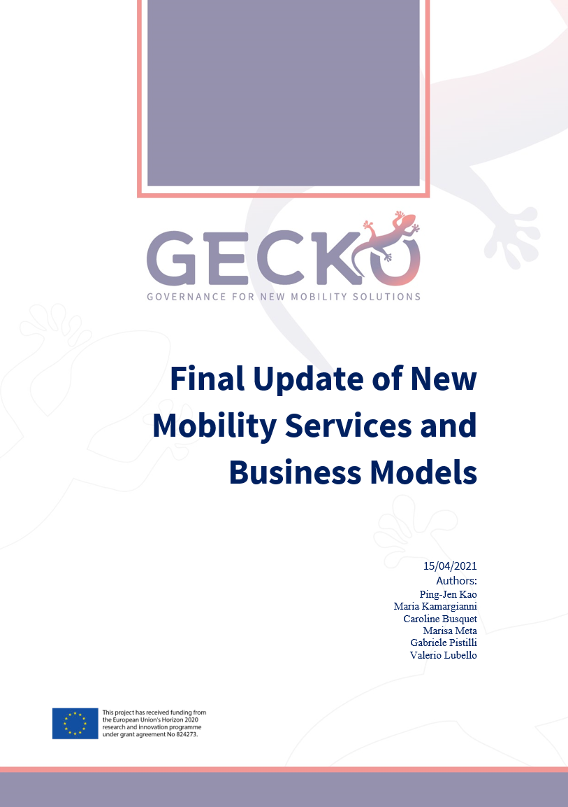
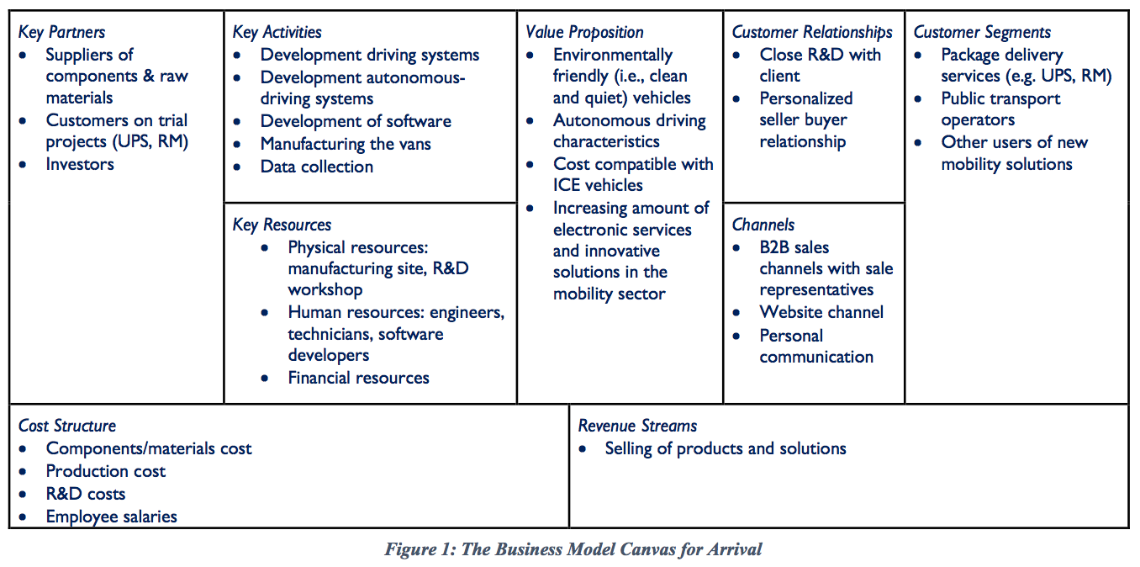
Final report on new mobility services and business models
Report covering market analysis, business models and the impact of COVID-19 on new mobility solutions
Coming to the GECKO website soon

Slide 27
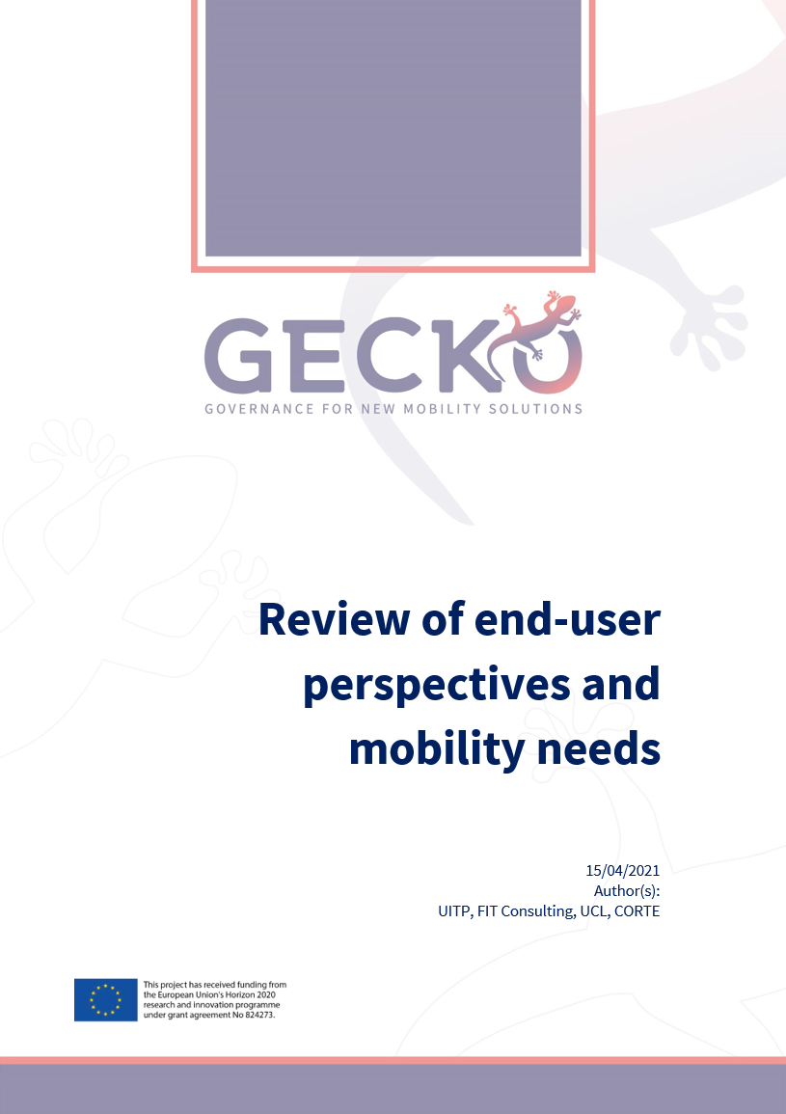
End Users’ Perception and Mobility Needs
Report covering end-users perspectives and their mobility needs of new mobility solutions
Survey for stakeholders coming soon
Coming to the GECKO website soon

Slide 28
PODCASTS
Regulating new mobility: Why is it so hard to do?
How much do we need to regulate new mobility?
New mobility: What’s the big deal about data?
Private versus public: The new mobility culture clash
Appearing monthly starting in late April.

Slide 29
COMING IN 2021
DATE TO BE ANNOUNCED
SEE YOU ALL AT THE GECKO FINAL EVENT

Slide 30
Thank you for your interest and attention
Yannick Bousse, UITP, yannick.bousse@uitp.org
Bonnie Fenton, Rupprecht Consult, b.fenton@rupprecht-consult.eu
Pedro Homem de Gouveia, Polis, pgouveia@polisnetwork.eu
Pasquale Cancellara, Polis, pcancellara@polisnetwork.eu
The sole responsibility for the content of this document lies with the authors. It does not necessarily reflect the opinion of the European Union. Neither the INEA nor the European Commission are responsible for any use that may be made of the information contained therein.

