Slide 1
Regulatory and governance frameworks for mobility innovations
FINAL CONFERENCE
Ignat Kulkov, Åbo Akademi University
25 and 26 August 2021

Slide 2
Contents
INTRODUCTORY SENTENCE
Economic, political and social variables influencing the governance of mobility innovations
Governance models and regulatory responses
Cooperation among private and public actors
Impact of COVID-19

Slide 3
Factors that influence the governance of mobility innovations

Slide 4
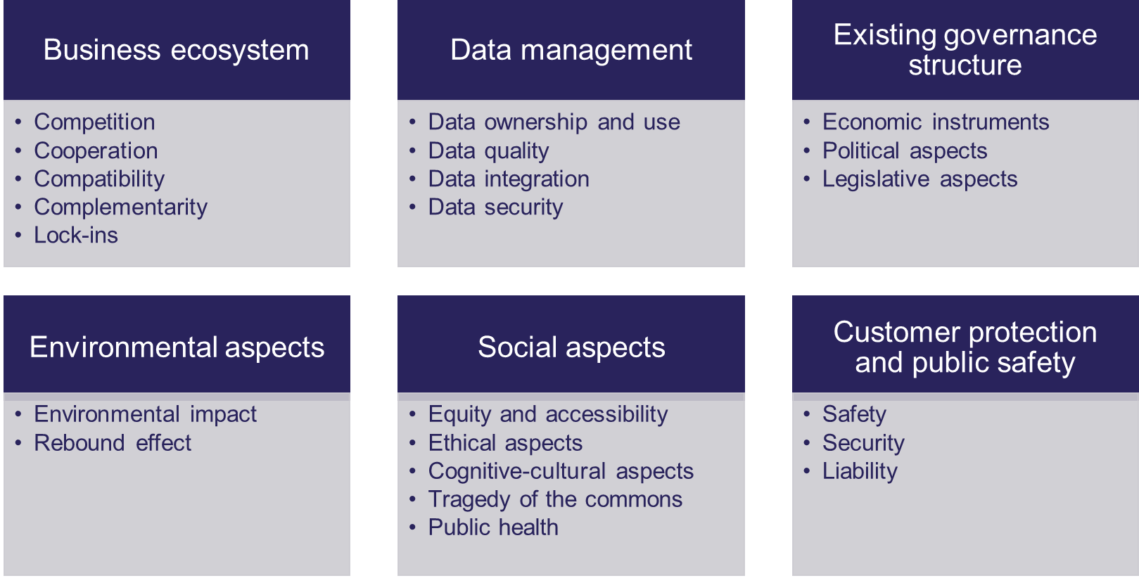
Economic, political and social variables influencing the governance of mobility innovations
WHAT NEEDS GOVERNANCE INTERVENTION?

Slide 5
Relevance of variables for the governance of different mobility innovations
Variable category name | CCAM | Infrastructure, network and traffic management | MaaS and MaaS platforms | Shared on-demand mobility
Competition | o | o | o | X
Cooperation | o | X | X | o
Compatibility | X | X | o | o
Complementarity | X | X | o | o
Lock-ins | X | X | X | X
Data ownership and use | X | X | X | X
Data quality | X | X | X | X
Data integration | X | X | X | X
Data security | X | X | X | X
Economic instruments | o | o | o | o
Political aspects | o | o | o | o
Legislative aspects | X | o | o | X
Environmental impact | X | o | o | X
Rebound effect | o | o | o | o
Equity and accessibility | X | o | o | o
Ethical aspects | X | o | o | o
Cognitive-cultural aspects | X | o | o | X
Tragedy of the commons | X | o | X | X
Public health | X | o | o | o
Safety | X | X | o | X
Security | X | X | X | X
Liability | X | X | X | X
Capabilities required for governing disruptive mobility:
Institutional power
Cross-sector coordination
Data management
Technical competences
Pro-activeness, experimentation
Innovation capability

Slide 6
Governance models and regulatory responses

Slide 7
Governance of different aspects at different levels (examples)
International level
International Transport Forum (ITF) at OECD – think-tank for transport policy
World Forum for Harmonization of Vehicle Regulations (UN) – harmonization of regulations
International Telecommunication Union (ITU) and the International Organization for Standardization (ISO) – work with UNECE to achieve the deployment of ITS
The Vienna Convention on Road Traffic and the Geneva Convention on road traffic – harmonization and standardization
UN Sustainable Development Goals
EU level
Directives and regulation regarding platforms, competition, taxation, public procurement and protection of personal data
EU policy: Strategy for a Sustainable and Smart mobility
Financing instruments: Connecting Europe Facility (CEF)
National and local level
Taxation, subsidies, funding, licensing, and access to infrastructure
Notes:
Not all governance tools are new, but some are still crucial and/or require updates to incorporate mobility innovations.
As regards the mobility sector specifically, policy makers at the EU level play a key role regarding the questions of safety, environment, funding, social protection, standardization, and competition. Certain areas related to mobility require regulation at EU level rather than following the subsidiarity principle and having decisions taken at national or local level due to the specificity of the issue at hand. This includes issues that are not directly related to any specific type of mobility innovations or require harmonization at higher than national level (e.g. when it concerns supranational infrastructures).

Slide 8
Applicability of different governance models

Slide 9
Cooperation among public and private parties

Slide 10
Cooperation models
COOPERATION MODELS
Memorandum of understanding
Contracts
No information sharing
Informal information sharing
Notes:
The entrance of new mobility players challenges the way public authorities regiment the relationship with service providers; namely the traditional contractual framework. Contracts based on detailed specifications, coupled with competition can constitute a rigid framework that prevents public transport services to evolve as well. Therefore instruments such as a memorandum of understanding that evolve over time can be preferred.
However when there is greater clarity on the service to be provided, then a more rigid contact could be used.

Slide 11
How formal is the private-public cooperation?
45 stakeholder responses
47% of public parties and 58% of private parties…
foresee the need to be clearer in the future about the formality of this relationship
32% of public parties and 38% of private parties…
have signed contracts that define their relationship with the private/ public sector
Private and public sector actors rated the importance of the cooperation at 8,8 out of 10
Notes:
Other options

Slide 12
Impact of COVID-19

Slide 13
Impact of COVID-19 on the governance of mobility innovations
Governance principles and models
International collaboration for resilient mobility, public-private partnerships
Collaborative
Collaboration with data service providers for adaptive policy-making based on data analysis
Adaptive
Pop-up infrastructure
Support for solutions to ensure social distancing and contact reduction
Sustainable recovery plans and acceleration of sustainable mobility and urban space allocation strategies
Outcome-based
Temporary re-spacing of cities to foster active modes of travel
Changes in urban planning​ and the status quo of the mobility mix
Regulatory sandbox
Reassuring passengers regarding transport safety, incentivising people to return to shared mobility
Raising awareness about individual responsibility and carbon footprint of journeys
Education
Restrictive rules
Restrictions related to social distancing and pausing pilots
Reduced R&D investments due to post-pandemic uncertainty
Short-term
Long-term
Impact on the governance of disruptive mobility innovations

Slide 14
Thank you for listening
Ignat Kulkov, Åbo Akademi University, ignat.kulkov@abo.fi
Anastasia Tsvetkova, Åbo Akademi University, anastasia.tsvetkova@abo.fi
The sole responsibility for the content of this document lies with the authors. It does not necessarily reflect the opinion of the European Union. Neither the INEA nor the European Commission are responsible for any use that may be made of the information contained therein.

